Slide 1
COMPANY RANGE BRIEF M-240B FT POLK, RANGE 8 OIC: SFC Clark NCOIC: SSG Cordero RSO: SSG Rideaux 28-30 May 2013

Slide 2
OUTLINE
MISSION
TASK, CONDITIONS AND STANDARDS
REFERENCES
QUALIFICATION
EXECUTION TIMELINE
RANGE PERSONNEL
RANGE LAYOUT
PRELIMINARY MARKSMANSHIP INSTRUCTION
CONCURRENT TRAINING
SERVICE SUPPORT
RETRAIN
SUCCESS

Slide 3
MISSION
41st TC , 88th BSB, conducts an M240B qualification range and DCRF focused Concurrent Training at Range 8 from 28FEB13 to 30MAY13 IOT check the serviceability of weapons, qualify select firers on their assigned weapon system and sustain GRF combat readiness of the 41st TC.

Slide 4
TASK, CONDITIONS AND STANDARDS
TASK: Conduct Basic Marksmanship Training and Qualification with the M240B Weapons System
CONDITION: Qualify with Individually Assigned Weapon On pop up targets in ACH, IBA, earplugs, gloves, protective eyewear, and camel back/canteens
STANDARDS: IAW FM 3-22.68

Slide 5
REFERENCES
Map, Ft. Polk Series V785S, Edition 1-DMA, 1:50,000
FM 3-22.68 Crew Served Weapons
JRTC & FP Supplement to FORSCOM Reg 385-1
FM 5-19 Composite Risk Management

Slide 6
QUALIFICATION
TABLE I 108 RDS (12 Zero)
TABLE II 144 RDS
TOTAL 252 RDS
252 Rounds Per Soldier
9000 Rounds issued ( 35 Soldiers)
20 Firers
Table I & II (139-156 Second Class, 157-185 First Class, 186-212 Expert)

Slide 7
EXECUTION TIMELINE (Detail)
Date/Time Activity 21MAY13 Brief Battalion Commander
20-23MAY13 PMI/ EST 2000
28-30MAY13 Daily Range Operations
0530 (Daily) Accountability formation (Company)
0600 (Daily) Weapons/Ammo Draw (Company) 0630-0730 (Daily) Breakfast 0730 (Daily) Range detail departs for Range 8
0800 (Daily) Range Goes Hot
1700 (Daily) Range Goes Cold
1700-1800 (Daily) Clear Range/ AAR/ Return to Garrison
1830 (Daily) Close-out report sent to BN S-3

Slide 8
EXECUTION TIMELINE (Firers)
Date/Time Activity 0630 (Daily) First Formation
0630-0810 (Daily) Breakfeast
00815 (Daily) Formation
0830 (Daily) SP to Range
NLT 0900-UTC Qualify on M240B

Slide 9
RANGE PERSONNEL
OIC: SFC Clark
NCOIC: SSG Cordero
RSO: SSG Rideaux
Tower NCO: SGT Harmon
Ammunition NCO: SGT Adams
Ammo Detail: SPC Jones, SPC Hire
RTO: SPC Monjue
CLS: SPC Rosas, SGT Karkee
Safeties: SSG Henry, SGT Hawkins, SGT Bonillo
Gate Guards: SPC Dukes, SPC Keys
Concurrent Trainer: SGT Satriano
DCRF Concurrent Trainer: SPC Velasquez, SGT Elmore
Armorer: SPC Reins
PMI Intructor: SGT Dixon

Slide 10
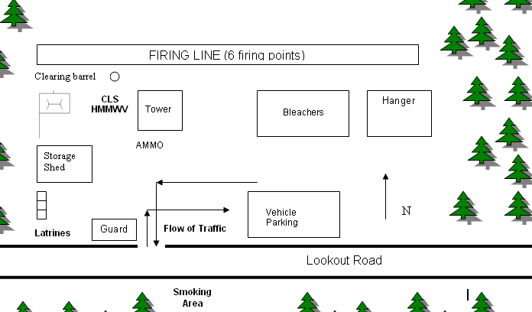
RANGE LAYOUT

Slide 11
PRELIMINARY MARKSMANSHIP INSTRUCTION
Manipulate the Trigger, Sight Picture, Immediate Action
Range Card
Qualification Tables
Assembly/Disassembly
Safe Operating Procedures

Slide 12
M 240B CONCURRENT TRAINING PRIMARY INSTRUCTOR: SGT Satriono
Concurrent training will consist of:
M-240B assembly and disassembly
Proper cleaning techniques for M-240B
Clearing procedures

Slide 13
DCRF CONCURRENT TRAINING PRIMARY INSTRUCTOR DCRF TASK: SPC Velasquez, SGT Elmore
Protect yourself from Chemical and Biological (CB) Contamination using your assigned Protective Mask.

Slide 14
SERVICE SUPPORT
CLASS I: All personnel are responsible for their own breakfast and lunch. Water will be supplied in five-gallon cans and water buffalo.
CLASS II: Range Uniform is ACH, IBA, hearing protection, eye protection, knee and elbow pads and wet weather gear
CLASS III: All vehicles will be topped off prior to movement to Range 8, CLP on site
CLASS IV, VI, X: N/A
CLASS V: 9000 rounds 7.62mm linked
CLASS VIII: 2 Combat Lifesaver bags
CLASS IX: Basic repair parts for M-240B will be provided

Slide 15
SUCCESS
Success at this range is defined as qualifying 100% of 41st TC M-240B firers without injury or incident.

Slide 16
M6

