Slide 1

M4 Familiarization and Range POC: 2LT Henry Janeway henry.j.janeway.mil@army.mil 248-410-6831
Ares Company

Slide 2
Training Timeline
Key Events
Land Requested
#of PAX verified
SMs attend any of the three SIM dates
AMMO successfully drawn
Actions on at the range
20-23 SEP 2024
Weapons Cleaning/ Turn in
19 SEP 2024
AAR/Recovery
19 SEP 2024
M4 Range
18 SEP 2024
M4 Group and Zero
17 SEP 2024
Pick up ammo from ASP (TBD)
17 SEP 2024
Draw Weapons from Tally
27 AUG 2024
SIM Center Date #3
26 AUG 2024
SIM Center Date #2
16 AUG 2024
SIM Center Date #1
TRAINING OBJECTIVES
08 August 2024
Verify # of PAX to be trained/ Train trainers
All SMs gain experience with the M4A1 rifle and either qualify expert or become more efficient with shooting from different positions.
24 July 2024
Book SIM Center
20 July 2024
WARNO to A CO. / AMMO Request
15 May 2024
LAND/ REQUEST
COMPLETE
IN PROGRESS
NOT STARTED

Slide 3
DOTS PLT, M4 Range
Gordon Range
Troops to Task
Exfil Plan
OIC: 2LT Janeway
NCOIC: SFC Cooper
RSO: SSG Sto Range Safeties:
1SG Stricklin
1SG Colorado
SFC Cooper
SPC Lopez
SGT Maye
Tower & RTO:
2LT Janeway
CPT Buono
Entry Control Point:
SPC Waller
SSG Walker
Ammo Detail: SGT Brown
SPC Duncan
Remedial Trainers:
SSG Scott
SSG Perry
Primary CLS: SGT Dominguez
Upon completion of firing the following will be conducted:
(1) Clear all weapons.
(2) Inspections of personnel are conducted to confirm all ammunition is turned in as required.
(3) Roadblocks and/or guards are removed/recalled.
(4) Police range for trash and debris
(5) Clean Latrines
(6) Trash and litter are separated from recyclables in plastic bags
(Later be delivered to the Material Recovery Facility).
(7) Report range discrepancies to unit leadership and Range Division, DPTMS.
(8) Obtain authorization from Range Control to clear training area.
(9) Obtain closing code from Alpha Base.
(10) Accountability for personnel & Sensitive Items transport soldiers back to ASP
Total:
Projected Weather: H: 87 L: 67

Slide 4
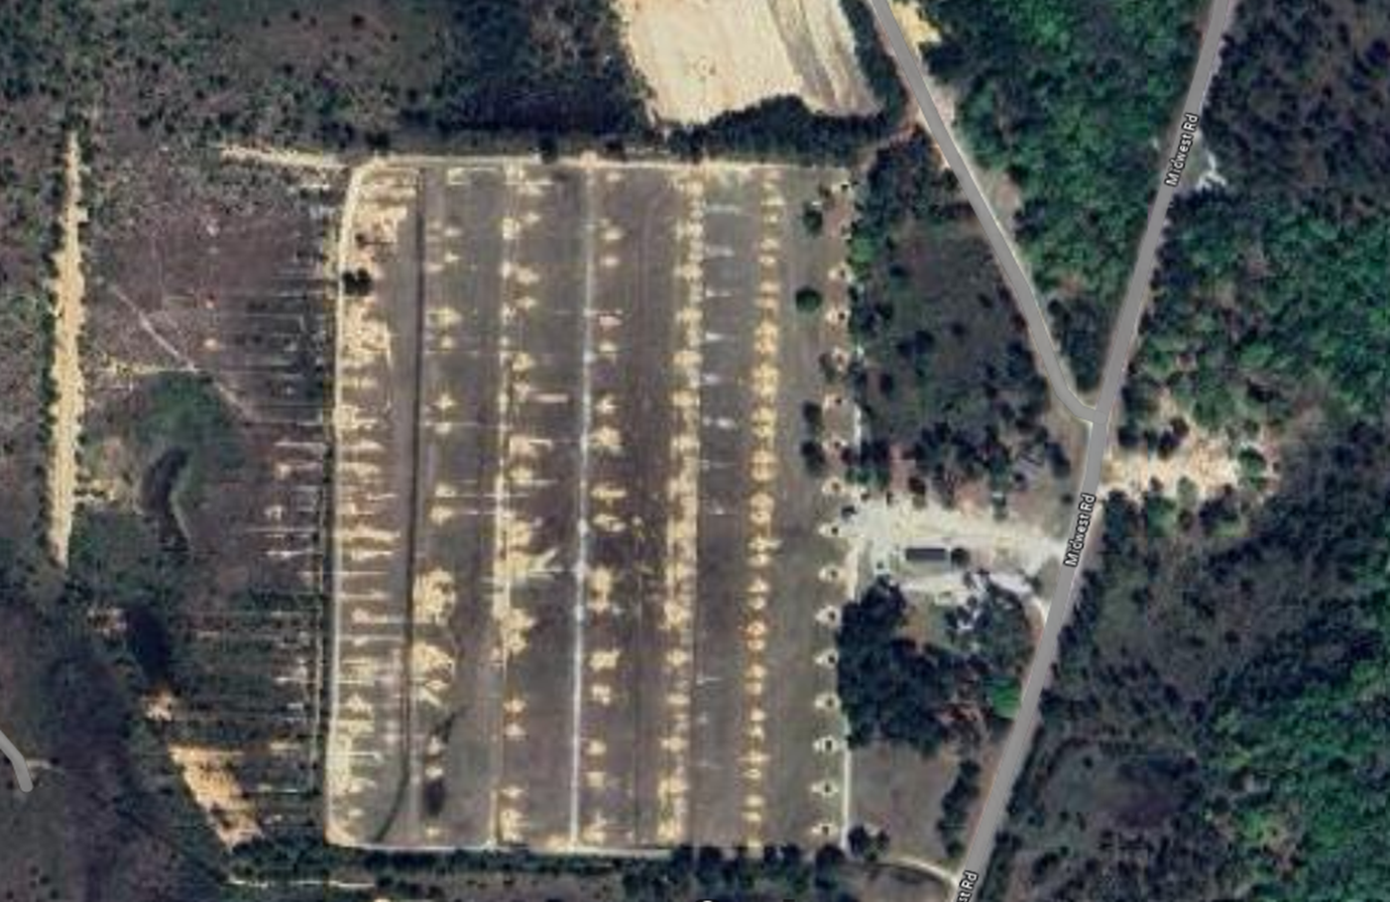
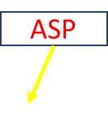



DOTS M4 QUALIFICATION
Contact
RNK Last, First
(###) ###-####
mil@army.mil
Mission: DOTS PLT, Alpha Company, 3-81 AR will conduct an M4 zero and qualification at Gordon range on 18-19SEP2024 IOT maintain proficiency in basic soldier skills.
Concept:
Phase 1: Refresher Training
This phase begins with M4 familiarization and PMI at BLDG 5310 on 15AUG. EST will be at the Wood Simulation Center on 16AUG, 26AUG, & 27AUG. This phase ends with all DOTS soldiers cycling through refresher and EST training.
Phase 2: Group and Zero
This phase begins with soldiers conducting the zero range and ends when all soldiers have successfully zeroed their weapon system.
Phase 3: M4 Qualification Range
This phase begins when soldiers begin their qualification and ends when all SMs have successfully qualified with the M4. Phase 4: AAR & Recovery
This phase begins when SMs police call the range and ends with an AAR.
Endstate: All SMs will successfully qualify with the M4
Sustainment:
ICE, Radios x6, ICE sheets, cooler x2, white board, markers, staple gun, staples, disposable ear pro, CLP.
Troops to Task:
OIC: 2LT Janeway
RSO: SFC Cooper
CLS: SGT Dominguez
Medical and Commo Plan:
P: Radio/ E911
A: Range Control
C: Cell Phone
E: GOV Truck (runner)

Slide 5

DOTS M4 Qualification
Mission: DOTS PLT, Alpha Company, 3-81 AR will conduct an M4 zero and qualification at Gordon range on 18-19SEP2024 IOT maintain proficiency in basic soldier skills.
Concept:
Phase 1: Train the Trainers
This phase begins with identifying trainers and ends with trainers being trained on objs.
Phase 2: Refresher Training
This phase begins with M4 familiarization and PMI at the Clarke Simulation Center on 16AUG, 26AUG, & 27AUG. This phase ends with all DOTS soldiers cycling through refresher and EST training.
Phase 3: Group and Zero
This phase begins with soldiers conducting the zero range and ends when all soldiers have successfully zeroed their weapon system.
Phase 4: M4 Qualification Range
This phase begins when soldiers begin their qualification and ends when all SMs have successfully qualified with the M4. Phase 5: AAR & Recovery
This phase begins when SMs police call the range and ends with an AAR.
End state: All SMs will successfully qualify with the M4.
Concept of Sustainment:
CL I: Water Buffalo, ICE
CL VII: Radios x6, batteries x6
CL VIII: ICE Sheets
CL X: Table x1, White Board x2, Markers x3, Cooler
Timeline:
16,26.27AUG: SIM Center 0900-1100 Open window
220630AUG24: Train NCOs
0700: First Formation at DOTS ASP
0730: SP from DOTS ASP
0800: Arrive at Gordon Range
0830: Safety Brief
0900: Range Goes Hot
1600: Range goes cold
1630: Police Call Range and Conduct AAR
1700: Depart Gordon Range
Commanders Comments:
Troops to Task
OIC: 2LT Janeway
RSO: SFC Cooper
CLS: SGT Dominguez
Heat Mitigation
Downgraded Uniform
AICS at ASP
Ice Sheets at ASP
Uniform
Taps, PC, Eyepro, Gloves, camelback, Earpro
Contact: 2LT Henry Janeway – (248)-410-6831 or Email
Henry.J.Janeway.mil@army.mil

Slide 6
DOTS M4 Range Layout
Tower
ASP
--
ECP

Slide 7
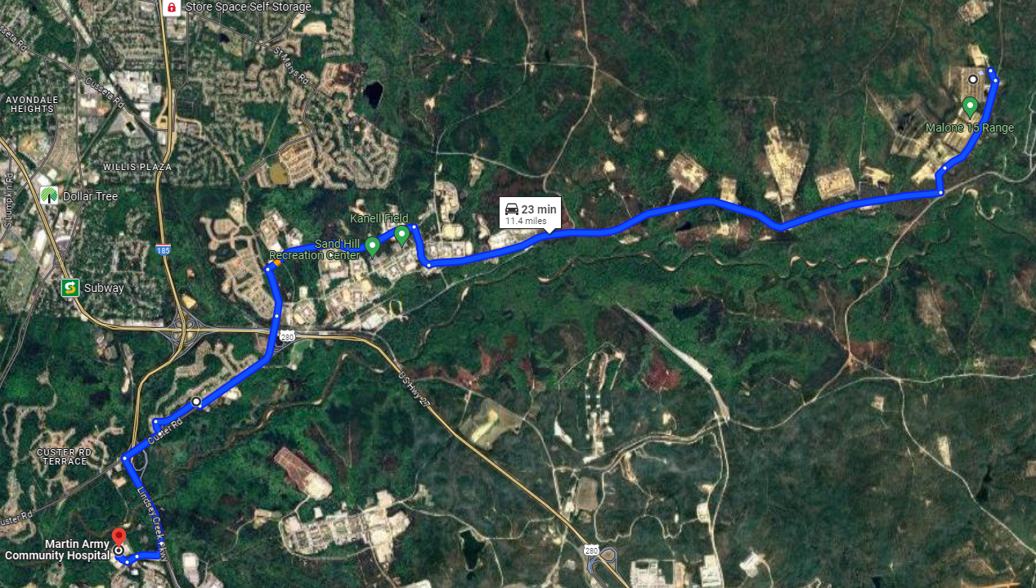
SUSTAINMENT
Primary Medical Route (AXP 5)
Supply
Medevac Plan:
Primary: Company Truck
Alternate: Radio to Range Control for Medevac
Contingency: Air MED
Comms (External):
Primary: ASIP (TBD)
Alternate: MACOM
Contingency: Cell
Emergency: Runner
Comms (Medical):
Primary: MACOM
Alternate: Cell
Contingency: Land Line
CLS PAX:
SGT Dominguez
Ammo Detail:
SPC Waller
SSG Walker
Tally Request
Equipment | O/H
M4 Rifle | 40
ACOG | 40
Ammo Request
AO77 | 6720
Item | O/H
MREs | 4 boxes
Trash Bags | 1 box
Ear Pro | 100ct
Engineers Tape | 1 Roll
Staple Gun | 2
550 Cord | 100 ft
Ice Sheets | 6
Wet Bulb | 1
Cooler | 2
1L Spray CLP | 2
CLP Jug | 1 Gal
Radios w/ batteries | 6
CLS Bags | 2
Fire Extinguisher | 2
AXP5
Safety Considerations
Uniform: While on the range, all SMs will be wearing TAPS, Eye Pro, Ear Pro, Gloves, and head covering
Handling of ammo: All ammo will be distributed from the ASP, and all magazines will be loaded by the ammo detail.
Weapon safety: OIC, RSO, Range Safeties will ensure weapons are oriented down range, on safe, and cleared before entering on the range.
Incident: If an incident occurs on the range, OIC/RSO will immediately call cease fire and report it to Range Operations.
Cease fire will remain in effect until the issue is resolved and cleared through Range Operations.
Medical: Range control and E911 will be contacted.
Heat mitigation: Two quarts of water, Water buffalo, Wet Bulb, Arm Immersion, Ice Sheets, Submersion Trough, Shade.
Alternate Medical Route (MACH)
.3 mi Turn right onto Van Aalst Blvd
6.2 mi Turn left onto Marne Road
1.1 mi Take left ramp onto 1st Division Rd
5.7 mi Turn left onto Wood Rd
1.5 mi Turn right towards 1st Division Rd
1.5 mi Slight left onto Red Arrow Rd
0.3 mi Turn left onto 2nd Armored Division Rd
138 ft Turn right onto Red Arrow Rd
1 mi Arrive at MACH

